Slide 1
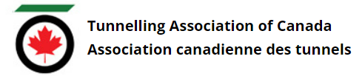
Tunnelling Association of Canada
Equity, Diversity, and Inclusion Moment
Allyship – Being an Ally

Slide 2
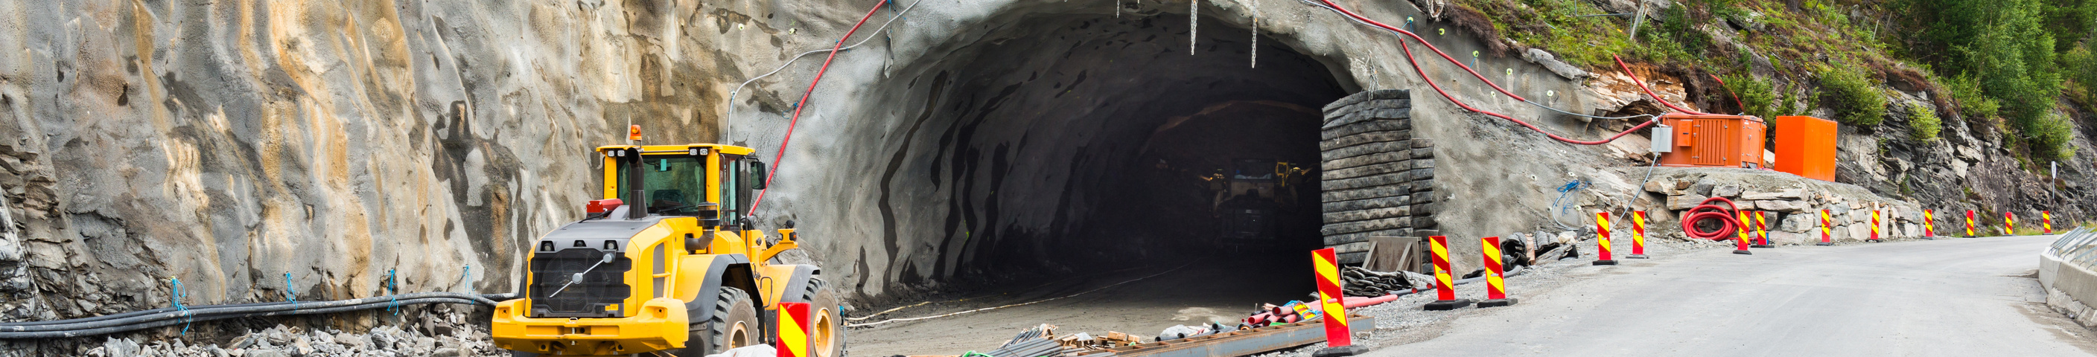
Tunnelling Association of Canada
What is an ally?
An ally is someone who supports and unites themselves with another individual or group to promote a common interest where both benefit.
Relating to diversity and inclusion, an ally is someone who actively and consistently seeks to end the systemic disempowerment of people belonging to a group.
Allies can help improve feelings of inclusion and belonging.
2

Slide 3
Tunnelling Association of Canada
How do I practice allyship?
Be a true listener
Respect people’s lived experiences when they share them with you
Provide solidarity
Stand beside, not in front of
Provide the support you are asked to provide, not what you would imagine would be helpful / what you want to do
Apologize for any mistakes (for example, incorrect pronouns, incorrect pronunciations) and move on without waiting for forgiveness (centering your own feelings)
Recognize that groups you wish to ally with are not homogenous in their thinking
3

Slide 4
Tunnelling Association of Canada
Date
Thank you!
The End

